Slide 1
CORPORATE TRAINING SYSTEM
SUPERVISOR: Mr. Nguyen Huy Hung
Team member: Le Phuc Thinh
Vo Thach Nguyen
Pham Chanh Hung
Dang The Anh

Slide 2
OUTLINE
Introduction
Implementation
Demostration
Values & Challenges

Slide 3

INTRODUCTION
1
Current Situation
2
Problems
3
Solution

Slide 4

Current situation
Traditional Training
Lack of human resources to conduct meeting and courses
Trainers have to train repeatedly
Students cannot have flexible time to study

Slide 5

Current situation
Send employees outside
Lower employees’ trust
Expensive solution

Slide 6

Current situation
Buy course online
Can not manage content of course
Can not manage learners’ process

Slide 7

Current situation
Share training program online
Lack of privacy on training courses
Loss of Control
User information can be exposed to third party

Slide 8

SOLUTIONS
Provide a system for corporations to train their employees with security and conveniences.
Analyze employees’ studies to make improvements base on results.
Corporations can manage their training plans and users participated in it with ease.

Slide 9

IMPLEMENTATION
1
System overview
2
Features
3
System architecture

Slide 10

SYSTEM OVERVIEW
Brand
Brand
Brand
Plan
Plan
Plan
Program
Program
Course
Course
Course

Slide 11
Course
Section
Section
Section
Lecture
Lecture

Slide 12
FEATURES
System Admin
Manage brands
Admin
Manage brand
Manage users
Manage plans
Manage programs
Manager
Manage skills
View report
Add/remove plan participants
Author
Manage course
Enroll course
Learner
Learn lecture
Take quiz

Slide 13


SYSTEM ADMIN
System admin
Manage list brands

Slide 14


ADmin
Admin
Manage brand

Slide 15

Manager
Manager
Manage user

Slide 16

Manager
Manager
Manage plans

Slide 17

Manager
Manager
Manage programs

Slide 18

Manager
Manager
Manage skills

Slide 19

Manager
Manager
View report

Slide 20

Manager
Manager
Manage participant

Slide 21

author
Author
Manage course

Slide 22

learner
Lear ner
Enroll course

Slide 23

learner
Lear ner
Learn lecture

Slide 24

learner
Lear ner
Take quiz

Slide 25
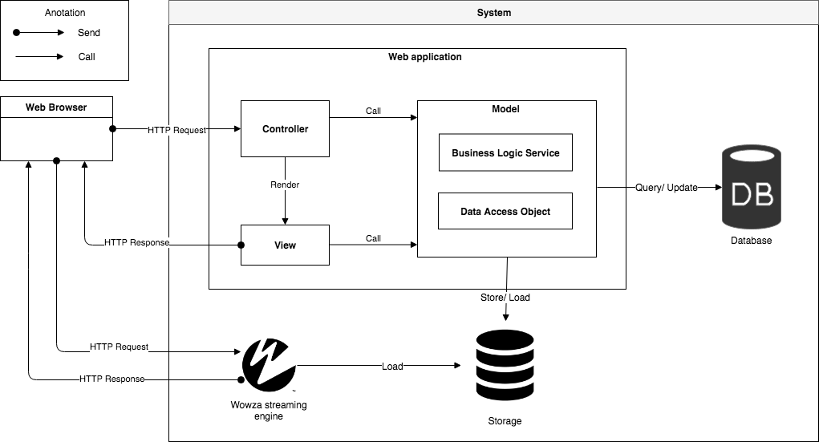
SYSTEM ARCHITECTURE

Slide 26

DEMONSTRATION

Slide 27
DEMO MANAGER: CREATE plan, Create program

Slide 28





PROCESS:
1. Open list plans page
2. Click create plan
Manager
Create plan popup
List plans page
3. Input information
4. Update plan infomation
Plan
Plan overview page

Slide 29



5. Add author to plan
6. Add learner to plan
Author
Learner
7. Click create program
8. Update program infomation
8. Fill infomation
Manage program
Create program popup

Slide 30
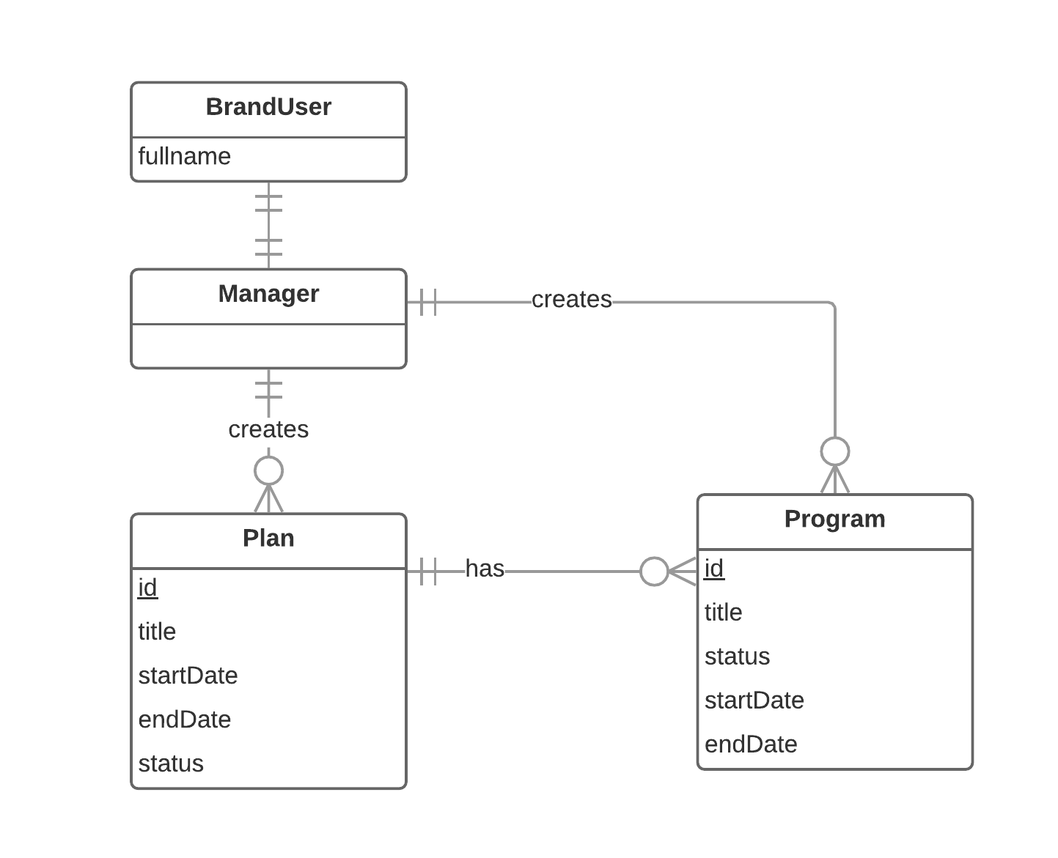
ENTITIES

Slide 31
DEMO author: CREATE LECTURE

Slide 32


PROCESS
1. Open list plan
2. Choose a plan
3. Choose a program
Author
List plan
Plan overview
5. Update course
4. Create a course
Course overview
Program
Notes:
Đầu tiên: tác giả bật traisy web app.
Tiếp theo: tác giả chọn khóa học trong danh sách khóa học của mình, sau đó tác giả bấm thêm bài học cho khóa học đó, , kế tiếp tác giả chỉnh sửa nội dung cho bài học
Cuối cùng: sau khi hoàn tất chỉnh sửa, tác giả lựa chọn “công khai” khóa học

Slide 33


6. Create section
7. Create lecture
Course
Section
Lecture overview
8. Update lecture
9. Send course to review
Lecture

Slide 34
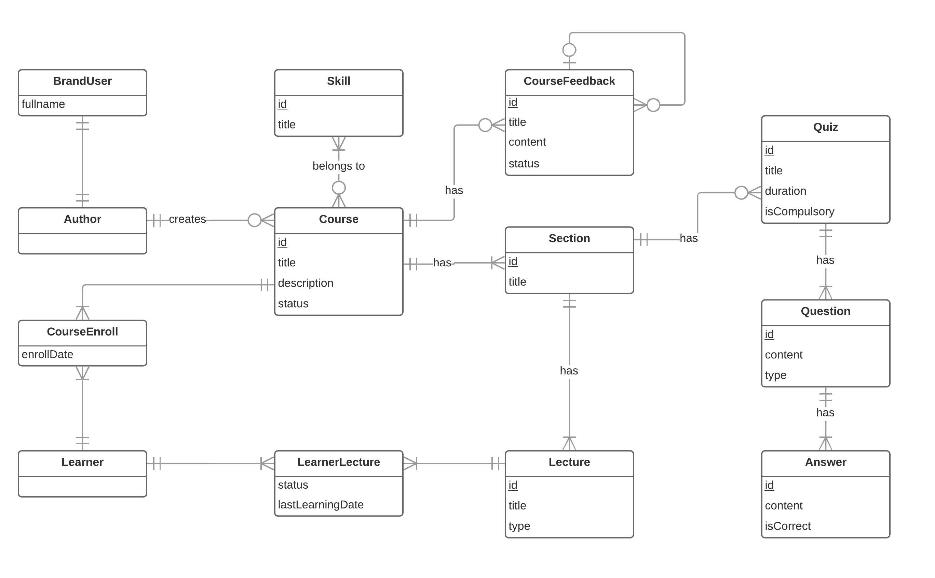
ENTITIes

Slide 35
DEMO MANAGER: REView course

Slide 36


PROCESS
1. Open review course page
2. Choose a
specific course
Manager
Review course page
Course overview page
3. Give feedback
4. Approve course
Feedback

Slide 37
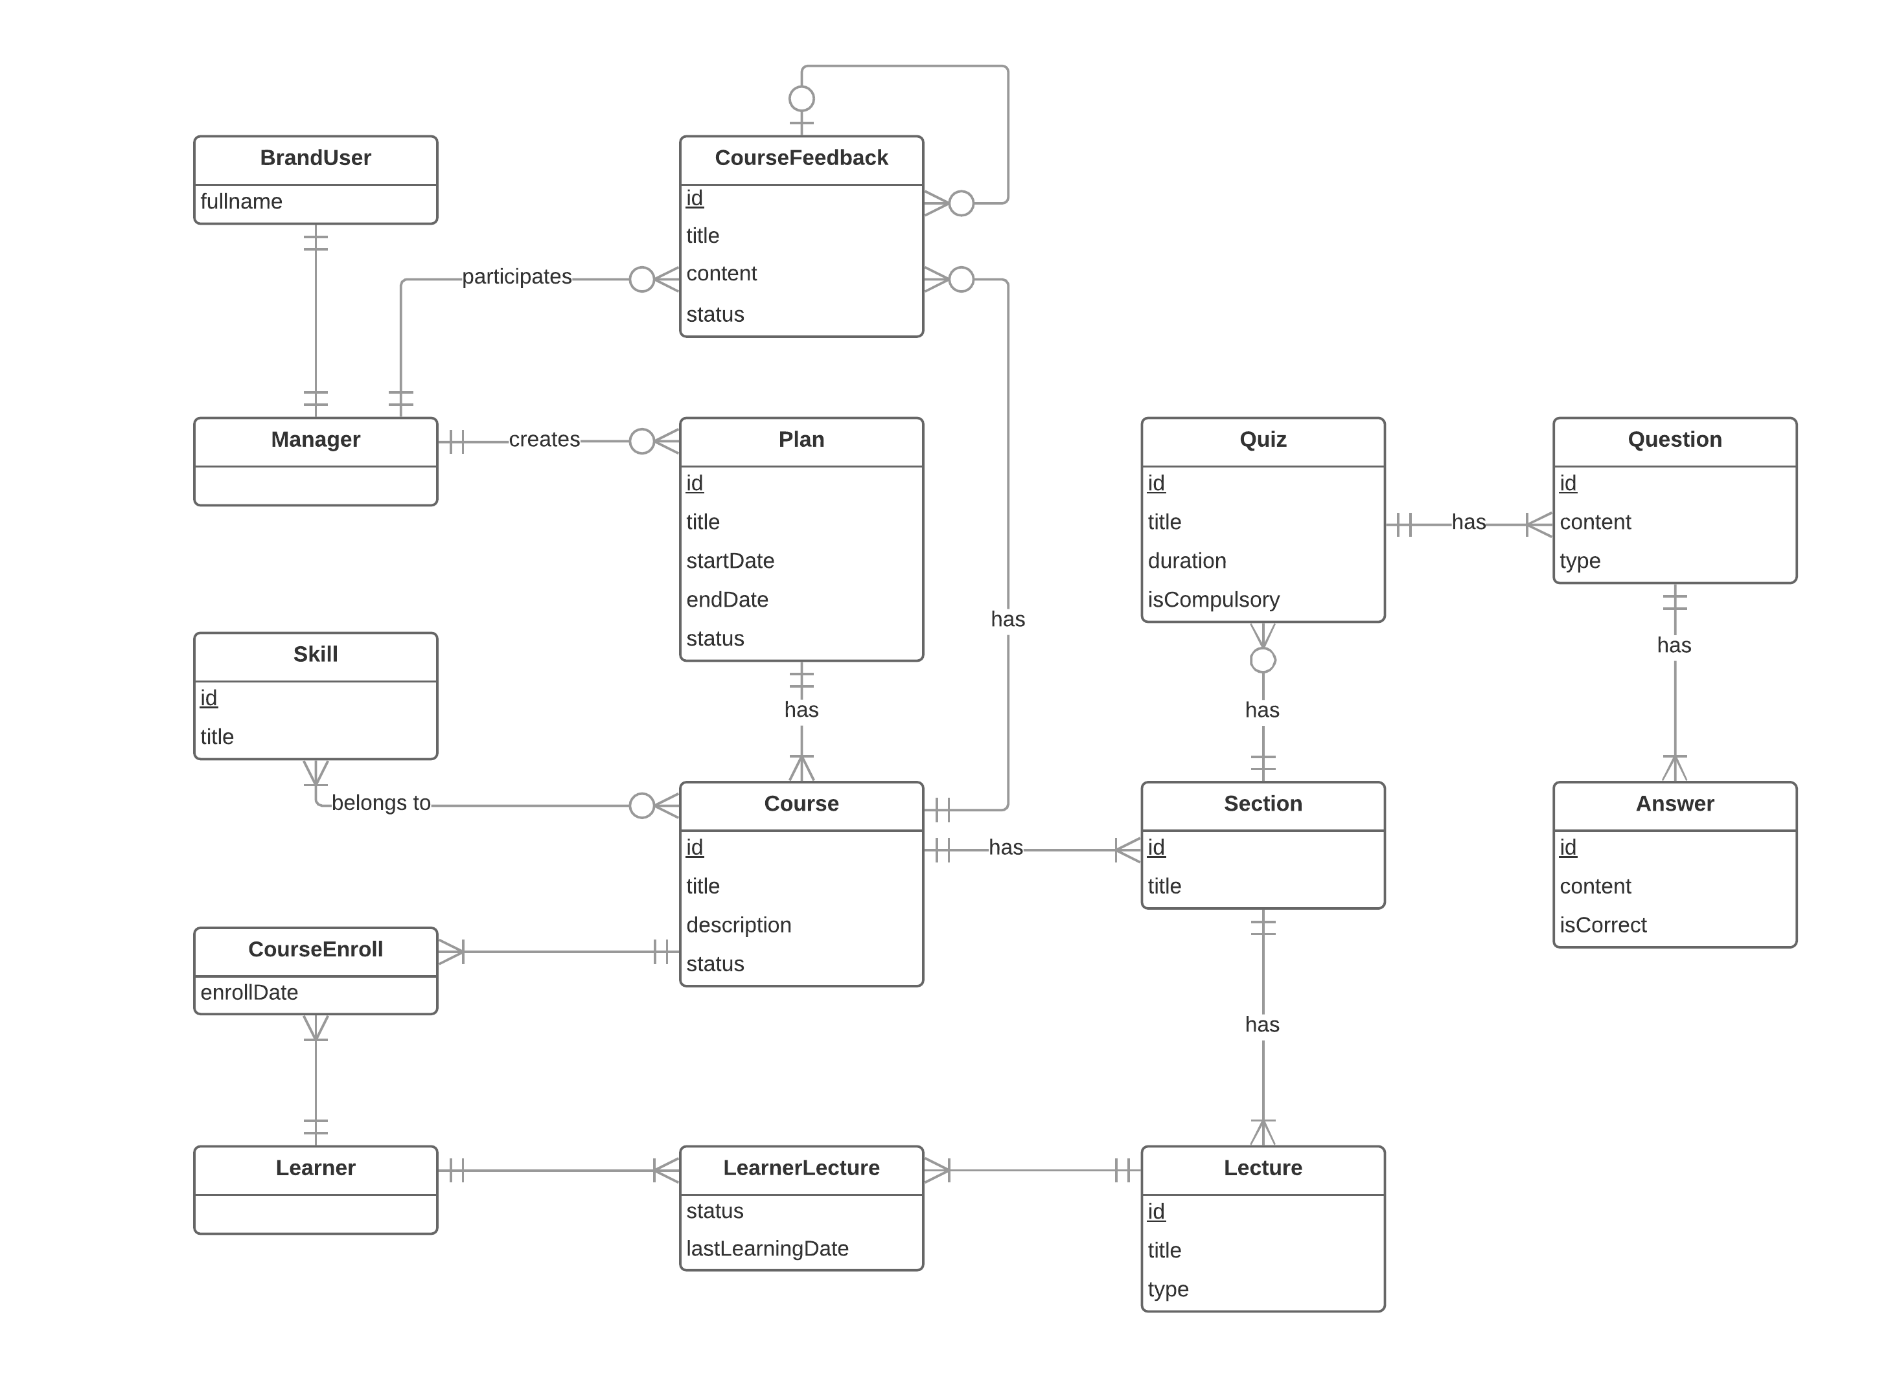
ENTITIES

Slide 38
DEMO Learner: Enroll course, learn lecture, take quiz

Slide 39
PROCESS
1. Open list plans page
2. Choose specific plan
Learner
List plans page
Plan overview page
3. Choose a specific program
5. Enroll
4. Choose a
specific course
Course overview page
Programs

Slide 40



5. Learn lecture
6. Take quiz
Learning page
7. View quiz
result

Slide 41
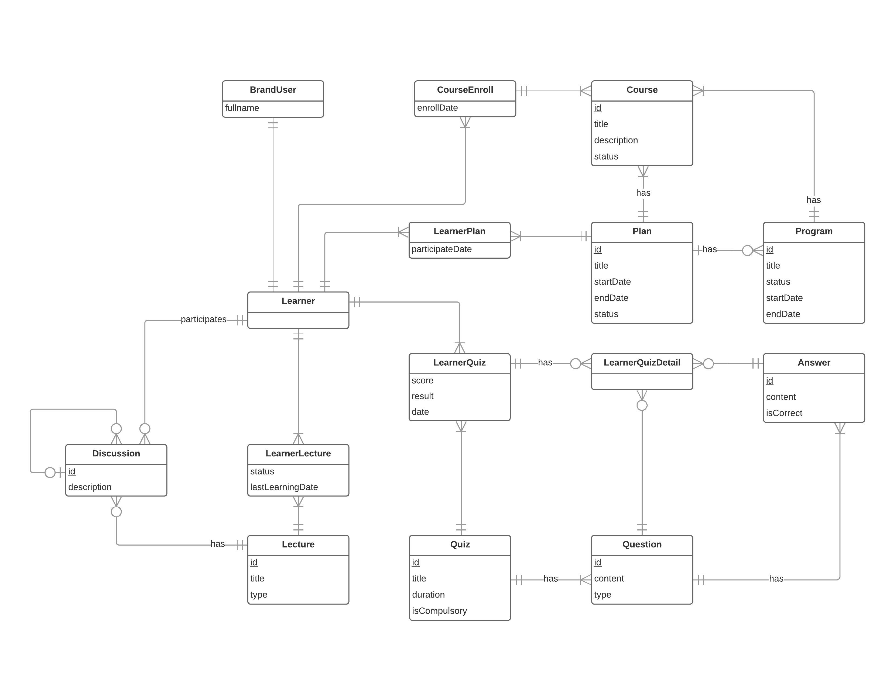
ENTITIES

Slide 42
DEMO MANAGER: View report -> View report detail

Slide 43



PROCESS
1. Open report page
2. Choose a
specific plan
Manager
Report detail page
Report page
3. Choose a learner/author
Detail information

Slide 44
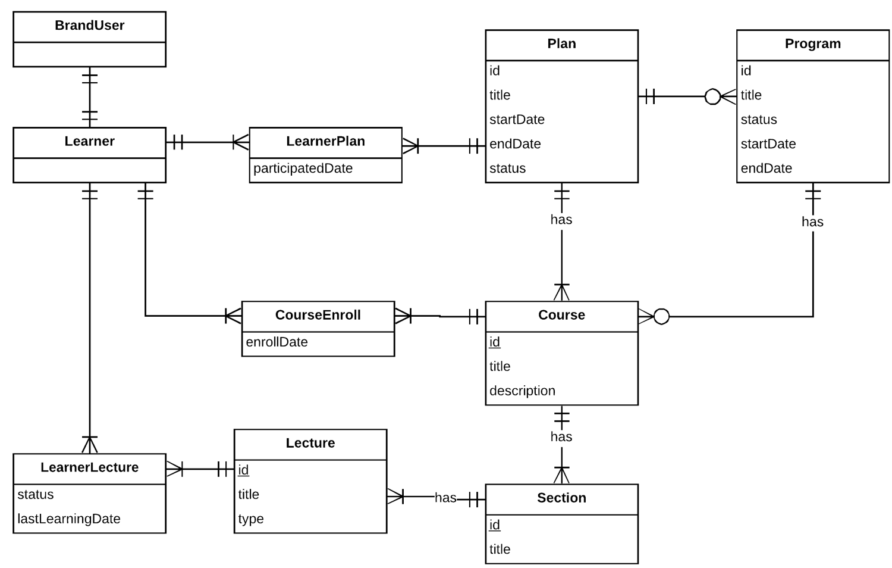
ENTITIES

Slide 45

VALUES
Tightness and clarity. There are different specific training plans, each consisting of programs and courses related to a particular field.
Monitor everything through reports or statistics.

Slide 46

CHALLENGES
Currently only supports the web platform
Limited learning resources

Slide 47

FUTURE PLANS
Develop and improve system on mobile platforms such as iOS, Android, ...
Expanse learning resource

Slide 48
THANK YOU FOR LISTENING

Slide 49


Slide 50
VALUES
Tightness and clarity. There are different specific training plans, each consisting of programs and courses related to a particular field.
Monitor everything through reports or statistics.

Slide 51
CHALLENGES
Currently only supports the web platform
Limited learning resources

Slide 52
FUTURE PLANS
Develop and improve system on mobile platforms such as iOS, Android, ...
Expanse learning resource

Slide 53
THANK YOU FOR LISTENING

Slide 55
Algorithm

Slide 56
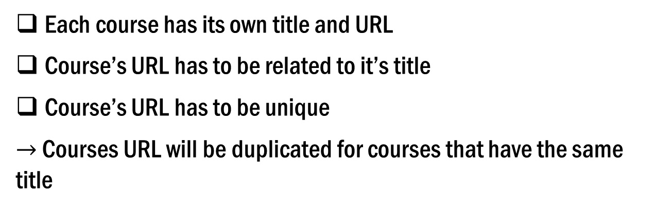
Define problem
Each course has its own title and URL
Course’s URL has to be related to it’s title
Course’s URL has to be unique
$→$ Courses URL will be duplicated for courses that have the same title

Slide 57
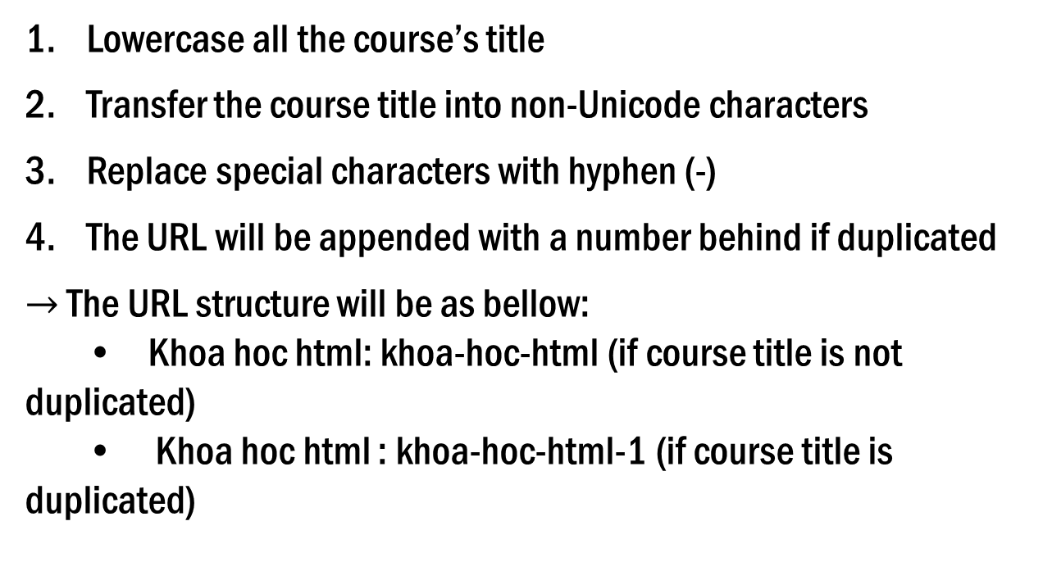
SOlution
Lowercase all the course’s title
Transfer the course title into non-Unicode characters
Replace special characters with hyphen (-)
The URL will be appended with a number behind if duplicated
$→$ The URL structure will be as bellow:
• Khoa hoc html: khoa-hoc-html (if course title is not duplicated)
• Khoa hoc html : khoa-hoc-html-1 (if course title is duplicated)

